Slide 1
Portsmouth Computer Group Remote Workforce
10/15/2020
PCG Technology Series

Slide 2
Welcome to PCG’s Technology Workshop
Todays Speakers from PCG
David Hodgdon (Founder, Cyber Security Expert)
Steve Ripper (Senior Engineer and Security/365 Expert)

Slide 3
Discussion Topics for today
How the Landscape has changed (COVID)
Statistics for the SMB Market
Company Policy, Processes & Standards
Video Conferencing Tips
Support/After hours
Security/Cyber Security “How this ties in”
How do we lower our risk together?
Q&A

Slide 4
Gartner Report
The “workplace” is a very different environment than it was just a 3 to 6 months ago. Technologies such as VPN that had fallen out of favor are now essential for maintaining a productive remote workforce. New research from Gartner offers businesses helpful guidance on how to quickly scale remote access for employees everywhere. Gartner recommends the following:

Slide 5
Gartner Report
Determine user remote access requirements such as on-premise or cloud applications before choosing or deploying any product
Test products for scale to support critical unplanned events such as COVID-19
Evaluate the risks of enabling unknown devices previously not used in the organization, such as bring your own Device (BYOD), Home PC, Notebook, Tablet, Public Wireless
Develop a usable remote work policy that all key stakeholders have agreed to. (Leadership/Management Team). This is critical that they all buy in and lead the way

Slide 6
Gartner Report
42% of the US labor force is working from home
33% are not working
26% Mostly Essential workers are on premise
40% of Employers offer flexible workplace options
Certain sectors felt little impact, others saw huge job losses as they did not have flexibility to work from home
Working remotely is a critical weapon to fight Covid 19, is economically essential
56% holds a job that is compatible with remote work
Allows for employee retention (Flexibility for key staff)

Slide 7
How the Landscape has changed
COVID
Weather, Power, Company Growth, Multiple sites
Remote worker issues
Company Policy/Procedures for Remote workers
Company Firewall (all employees should be running through this)
Don’t use a Home-based PC
Company owned equipment & Managed
Kids/School, Family, Parents, Employee Preferences (Health)
Distractions/Not focused on the bad guys “Actors”
Security Services not in place
Phones/VOIP
This is one of the gateways for your clients and prospects to reach you
Training

Slide 8
Company Policy, Processes & Standards
Remote Workforce Policy
What is accepted or not
Remote access (VPN/RDP, Cloud)
File Access/Permissions

Slide 9
Company Policy, Processes & Standards
Process/Checklist for an employee to work from home
Hiring Process, Background Check
Timesheets
Monitoring for tracking remote workers
Management check-ins
Hours- kids with school, Parents

Slide 10
Company Policy, Processes & Standards
Standards
Company owned PC/Notebook - Managed
Private Wireless, don’t use public Wireless
VPN/Security
Don’t use your cell Phone on the Private wireless
Security in place (AV, DNS, SPAM/365, Updates)
Security Awareness Training

Slide 11
Video Conferencing Tips
Be ready / 8am-5pm
Dressed for success. You are the face of your Company
Webcam/Mic Quality
Mount on the monitor directly facing you
Always have the Video on and be prepared
Background/noise
Background-know what your audience is seeing
Know when to use a Headset
Mute/Turn off Mic when not talking
Headset/Noise Cancelling/Wireless
PCG has invested in the best headsets for our staff
Quality Audio/Sound for the best client experience
Removes some of the background noise

Slide 12
Video Conferencing Tips
Add Teams/Zoom App to your Cell Phone
Be ready to take Calls/Appts when needed
Scheduling
Sending invites out. Be Prepared!!
Know how to use Teams, Zoom, etc.
Train your staff
New Features in Teams – Pretty cool stuff ☺
Confirm you have the most recent updates
Teams. You can add a MS 365 Phone Subscription
Service to invite Prospects/Clients/Vendors to join your call
You need to make a difference. Standout !!

Slide 13
Support After Hours
Does your Company and Staff need Help Desk Support after hours?
Many employees now are:
Taking care of their kids and helping with School work
Assisting parents/family members
Working different hours now to get their 40 hours in & do their job
PCG offers 24x7 Help Desk support now
This was a critical service to put in place since Covid
Chat/Phone Call

Slide 14
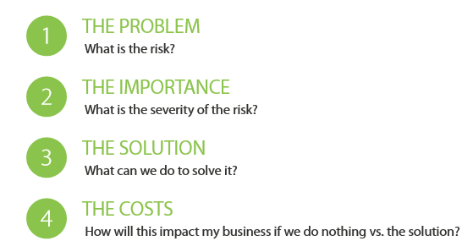
Readers Digest Version Remote Workers Security

Slide 15

Cyber security at all time high since Covid
Ransomware attack every 11 seconds
There have been more Ransomware incidents in the last 6 months than there were in the past 2 years
82% of Companies Lack the Funds to Deal with the Repercussions of a Cyber Attack
The Average Cyber Attack Carries a Price Tag of 100k to $5 Million for the SMB
Experience 14+ Hours of Downtime During a Breach
1 in 243 Emails are Malicious

Slide 16
Remote Workers Security/Cyber Security
Remote Workforce Security Concerns and Steps to resolve (Plan)
Security Risk Assessment
Why this is needed and the Value to your Business
Company Standards/Expectations
Cyber Security Basics
PW Manager, MFA, SAT, Encryption, SPAM
Business Continuity, 365 email backup, Imaging (“RTO”)
Firewall, EDR, Intrusion Detection
Remote Workforce Policy
What is accepted and not
Compliancy
NIST, CMMC “Cyber Maturity Model Certification”, HIPAA
Compliance by Industry

Slide 17
Top 3 Action items to be thinking about
Remote Workforce Policy
What are they doing all day
How can you manage and control this
Standards
Security Stack (Layers needed)
- Every Business/Industry is different

Slide 18
How do we lower our RISK together?
You “The Company” ultimately owns the data and how you will manage (what is acceptable) your Remote workforce
The decisions you make will determine your outcome
Advanced threats have created the need for advanced security, and it can’t be solved by technology alone
Human Factor is what the Cyber Criminals are banking on
Awareness is the first step
Remote Workforce
PCG provides custom Security Training Sessions
Simulated Phishing Campaigns/Educate your employees
Strong Passwords and MFA are CRITICAL!!

Slide 19
How can you minimize your risks
There are many things you can do
It all starts with having a plan
AUP “Acceptable use Policy”
Key Focus now is on your Remote Workforce
Compliancy
For your Business and Industry

Slide 20
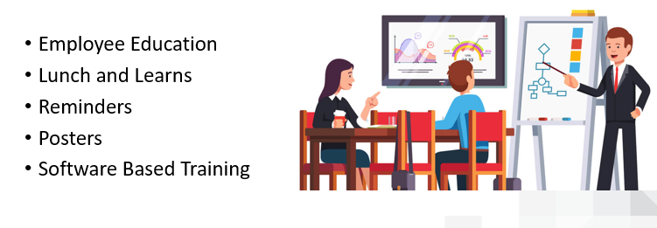
Employee Education

Slide 21
Next PCG Technology Series
Our next Workshop will be on November 19th
Security Risk Assessments
Process
Compliance
Industry Specific
Vulnerability Scans
Expectations/Deliverables

Slide 22
Q&A/Raffle
Questions
Raffle-$100 Amazon Gift Card
Thank you for your time

